Slide 1
Wild Rydes Workshop
Module 1: Web Application
Social handles

Slide 2






What are we building?
Content Delivery
API Layer
Application Layer
Persistency Layer
Get Credentials
Amazon
Cognito
Amazon
API Gateway
AWS
Lambda
Amazon
DynamoDB
Static Content
AWS Amplify
Notes:
From CloudFront to Dynamo
From S3 to client.
All authz with cognito.

Slide 3

What are we building?
Content Delivery
API Layer
Application Layer
Persistency Layer
Get Credentials
Amazon
Cognito
Amazon
API Gateway
AWS
Lambda
Amazon
DynamoDB
Static Content
AWS
Amplify
AWS
AppSync
Notes:
From CloudFront to Dynamo
From S3 to client.
All authz with cognito.

Slide 4
Services used

Slide 5


Serving Static Content
Amazon
CloudFront
Amazon
S3
Icon made by FlatIcon
Notes:
Amazon Simple Storage Service is one of AWS’ oldest services – it’s a massively scalable object store that provides serverless storage.
It stores trillions of objects and regularly handles millions of requests per second and provides effectively infinite storage without any provisioning.
Like other serverless servers, it provides continuous scaling, you never pay for idle resources, and allows you to focus on your application rather than commodity object storage.

Slide 6
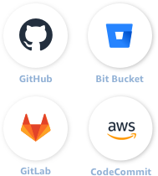

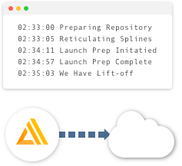
AWS Amplify Console
Build, deploy, and host cloud-powered modern web apps
1. Connect your repository
2. Configure build settings
3. Deploy your app
Optional deployment of backend resources + fully managed frontend hosting
Notes:
New way to serve static content: AWS Amplify Console
1. Connect your repository
2. setup build settings, provides templates for common frameworks (e.g. React, Hugo, Jekyll, etc.)
3. Deploy your application, uses S3 and CloudFront under the hood but takes care of cache invalidation, atomic deployments, etc.

Slide 7


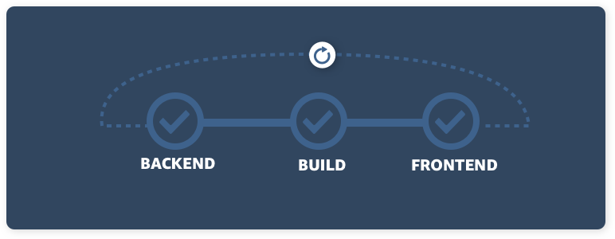
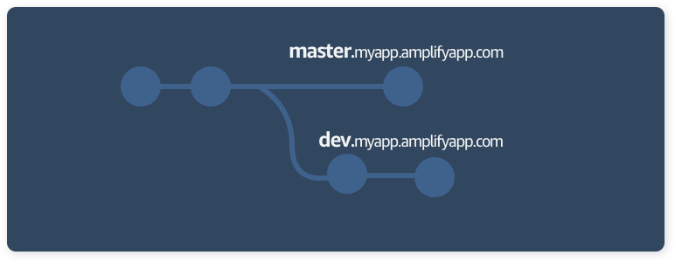


AWS Amplify Console
Globally available
Your app is served via Amazon's reliable content delivery network with 144 points of presence globally.
Easy custom domain setup
Set up custom domains managed in Amazon Route 53 with a single click plus get a free HTTPS certificate.
Simplified continuous workflows
Connect your repository to 'git push' changes to your frontend and backend in a single workflow.
Feature branch deployments
Work on new features without impacting production. Create branch deployments linked to each feature branch.
Atomic deployments
All deployments either rollout successfully or fail without requiring maintenance windows.
Password protection
Share yet-to-be released features with internal stakeholders by setting a username and password.

Slide 8
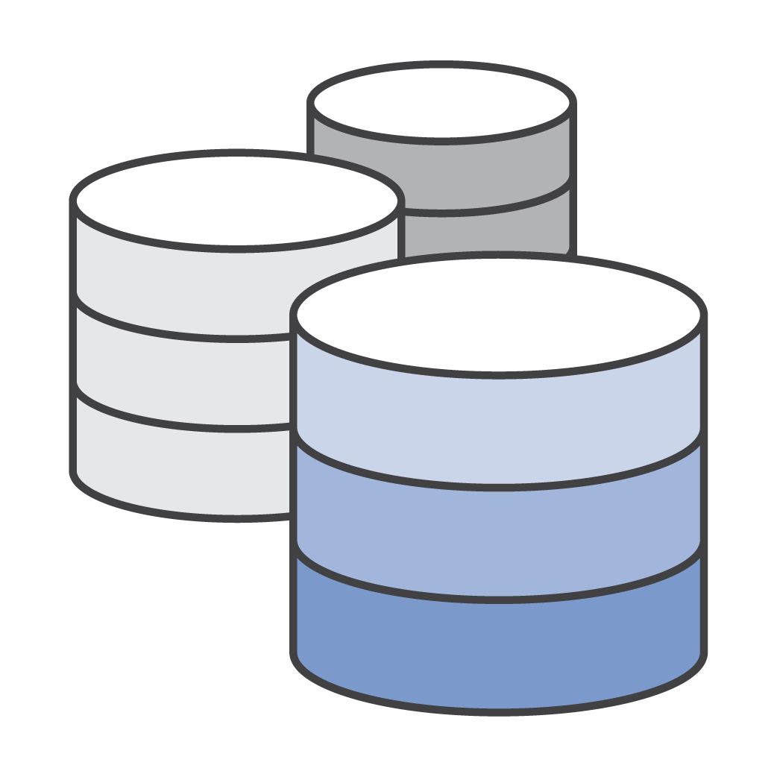
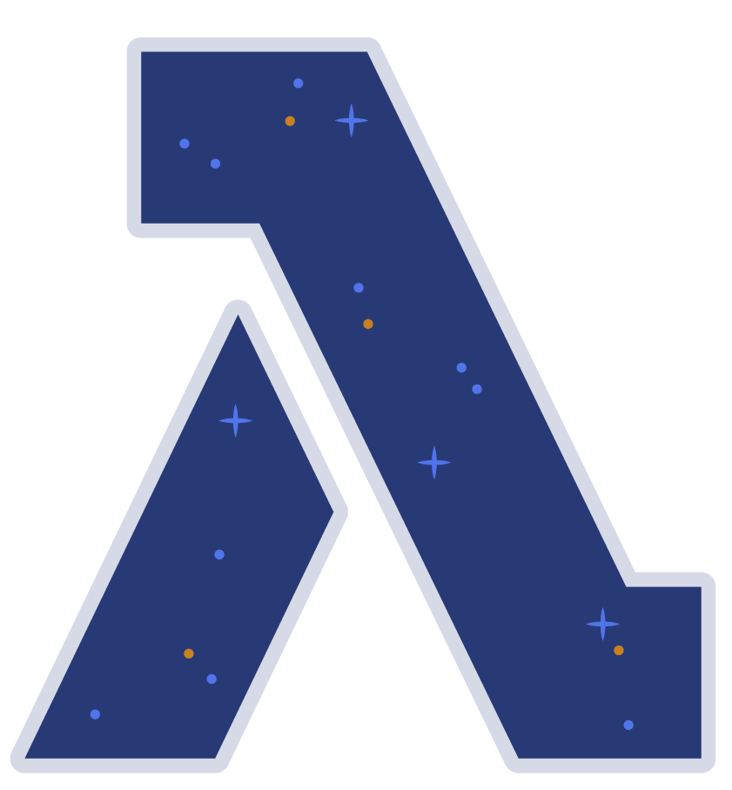



AWS Lambda: Serverless Computing
EVENT SOURCE
FUNCTION
SERVICES (ANYTHING)
Changes in data state
Node.js
Python
Java
C#
Go
PowerShell
Ruby
Requests to endpoints
Changes in resource state
Notes:
The model of compute is simple: you have an event coming from an AWS service or an invocation, a request coming from an endpoint or a change on a resource and your code gets executed.
This code can be built with virtually any kind of language. We, out of the box, support and manage these ones but you can build you custom runtime.
From this code, do what your business need! Connect to services, public endpoints, calculations, DBs, transformation. Basically, code.
15 mins execution limit
Event driven

Slide 9

Anatomy of a Lambda function
Handler() function
Function to be executed upon invocation
Event object
Data sent during Lambda Function Invocation
Context object
Methods available to interact with runtime information (request ID, log group, etc.)
s3 = boto3.resource('s3')
app = App()
def lambda_handler(event, context):
# do something
...
Notes:
Event object: The event that triggered this code. For example, the content of an API request, the item of an SQS queue item, the location of a file on S3.
The context gives you information about the actual execution of the lambda.

Slide 10

Fine-Grained Pricing
Buy compute time in 100ms increments
Low request charge
No hourly, daily, or monthly minimums
No per-device fees
Never pay for idle
Free Tier
1M requests and 400,000 GB-s of compute.
Every month, every customer.
Notes:
This free tier doesn’t have a limit of 1 year

Slide 11








Using AWS Lambda
Bring your own code
Node.js, Java, Python, C#, Go, Powershell, Ruby
Bring your own libraries (even native ones)
Simple resource model
Select power rating from 128 MB to 3 GB
CPU and network allocated proportionately
Flexible use
Synchronous or asynchronous
Integrated with other AWS services
Flexible authorization
Securely grant access to resources and VPCs
Fine-grained control for invoking your functions
Notes:
CPU and network are allocated based on the memory selected. Muti from 1.5GB

Slide 12
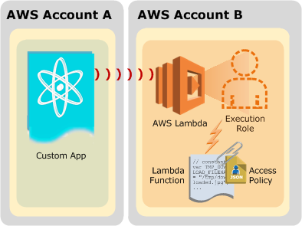
Lambda permissions model
Fine grained security controls for both execution and invocation:
Execution policies:
Define what AWS resources/API calls can this function access via IAM
Used in streaming invocations
E.g. “Lambda function A can read from DynamoDB table users”
Function policies:
Used for sync and async invocations
E.g. “Actions on bucket X can invoke Lambda function Z"
Resource policies allow for cross account access
Notes:
Execution policies: What can my lambda do? Which services can this lambda reach?
Function policies: Who can execute this lambda?

Slide 13




Using AWS Lambda
Authoring functions
Cloud9
WYSIWYG editor or upload packaged .zip
Third-party plugins (Eclipse, Visual Studio)
Monitoring and logging
Metrics for requests, errors, and throttles
Built-in logs to Amazon CloudWatch Logs
X-Ray integration
Programming model
Use processes, threads, /tmp, sockets normally
AWS SDK built in (Python and Node.js)
Stateless
Persist data using external storage
No affinity or access to underlying infrastructure
Notes:
You can develop your Lambdas from an IDE, Cloud9 or from the console itself (not recommended for real purposes as this is not a suitable IDE).
/tmp used for caching. Expect no lambda reutilization (ephemeral compute!)
SDKs are pre-built inside of the lambda execution.
X-ray integration = one single checkbox.

Slide 14




Lambda execution models
Asynchronous (event)
Synchronous (push)
Poll-based
Amazon
API Gateway
Amazon
DynamoDB
Amazon
SNS
Amazon
Kinesis Data Streams
Amazon
S3
/order
reqs
changes
AWS
Lambda
AWS Lambda service
AWS Lambda function
AWS Lambda function
function

Slide 15



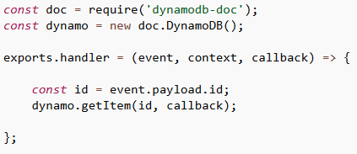
Accessing stored data in Amazon DynamoDB
Simple
GetItem(primaryKey)
PutItem(item)
Applications
Amazon
DynamoDB
Accelerator (DAX)
Amazon
DynamoDB
Amazon DynamoDB - Streams
Notes:
The second service we’ll look at is DynamoDB. We’ll be using DynamoDB extensively in our workshop.
You can think of DynamoDB as a serverless database in a similar way to Lambda as serverless compute. As I mentioned, persistence was an anti-goal for Lambda, DynamoDB provides a persistence layer that you can leverage for your applications without managing servers.
It’s a fully managed NoSQL database designed to provide consistent, single-digit millisecond latency regardless of scale.
It supports both document and key-vale data structures similar to other NoSQL data stores you may have worked with in the past.
DynamoDB is fully integrated with Lambda in that you can build a Lambda function to execute and react to data changing within DynamoDB as a database trigger.

Slide 16
DynamoDB Table
Table
Items
Attributes
Partition
Key
Sort
Key
All items for key
==, <, >, >=, <=
“begins with”
“between”
“contains”
“in”
sorted results
counts
top/bottom N values
Mandatory
Key-value access pattern
Determines data distribution
Optional
Model 1:N relationships
Enables rich query capabilities

Slide 17


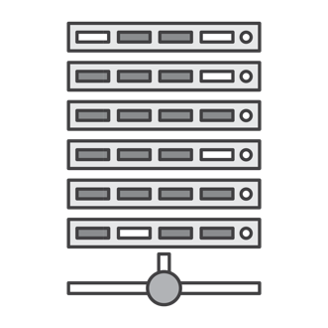




Amazon API Gateway
Create a unified API frontend for multiple micro-services
DDoS protection and throttling for your backend
Authenticate and authorize requests to a backend
Throttle, meter, and monetize API usage by 3rd party developers
Notes:
Managed API Platform
From edge to private APIs (Edge, regional, access to VPC and private APIs)
Openapi compatible
From API to any endpoint (inside or outside of AWS).
Monitored via CW.
Super easy Lambda Integration.
--------------
Many features – Models, Cache, Usage Plans

Slide 18












API Gateway - Serving Dynamic Content
AWS Cloud
AWS Identity and Access Management
Amazon
Cognito
AWS
Lambda
AWS
Lambda
Mobile client
API Authorization
API Gateway Cache
Amazon
EC2
Client
Amazon
CloudFront
Amazon
API Gateway
Internet
All publicly accessible endpoints
AWS Managed Services
Services
Amazon
CloudWatch
Amazon VPC Endpoints
Notes:
Managed API Platform
From edge to private APIs (Edge, regional, access to VPC and private APIs)
Openapi compatible
From API to any endpoint (inside or outside of AWS).
Monitored via CW.
Super easy Lambda Integration.
--------------
Many features – Models, Cache, Usage Plans

Slide 19
Amazon Cognito
Add user sign-up, sign-in, and data synchronization to your apps
Add user sign-up and sign-in to your mobile and web apps
Federate identities and provide secure access to AWS resources
Store and sync across devices
Notes:
Amazon Cognito is a user management service. Instead of building, securing, and scaling a system to handle user management, authentication, and data synchronization, you can instead focus on creating great app experiences.
Every product development cycle contains a few weeks of undifferentiated items like “build a login flow” and “create a password reset system.” Cognito gives you a speed boost by taking care of these rote backlog items for you.
Cognito is integrated with third party login provides like Facebook, Twitter, Google, Amazon, or any third party identity provider that exposes a SAML interface. Likewise, with Cognito your user pools, you can manage your own users in the cloud securely without spending any time architecting your own identity system.

Slide 20






Serving Dynamic Content - GraphQL
Legacy
Application
Amazon
RDS
Traditional server
Cognito
User Pool
Amazon
DynamoDB
Amazon
Elasticsearch
Amazon
Cognito
GraphQL
Schema
Mobile client
Real-time
Online/Offline
Upload
Schema
AWS AppSync
GraphQL
Query
Mutation
Subscription
Client

Slide 21
Let’s build!
http://bit.ly/WildRydes-Module1

