Slide 1
Wild Rydes Workshop
Social handles

Slide 2
Notes:
Present this video

Slide 3
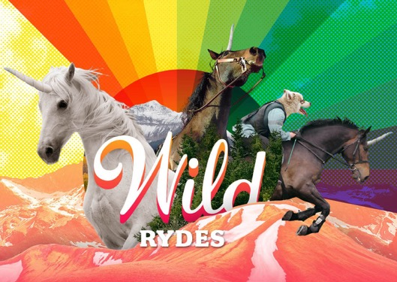
Scenario: Wild Rydes (www.wildrydes.com)
Notes:
In this scenario, we’re building a marketing site for Wild Rydes, which is a fictional transportation startup that allows you to hail a unicorn from anywhere in the world.
Wild Rydes was started by a former hedge fund analyst and a software developer. The two long-time friends happened upon the Wild Rydes idea after attending a silent yoga retreat in Nevada. They saw an opportunity to marry society’s demand for faster, more flexible transportation to underutilized magical creatures through an on-demand transportation network app. Using the founders’ respective expertise in animal husbandry and software engineering, Wild Rydes was formed!

Slide 4
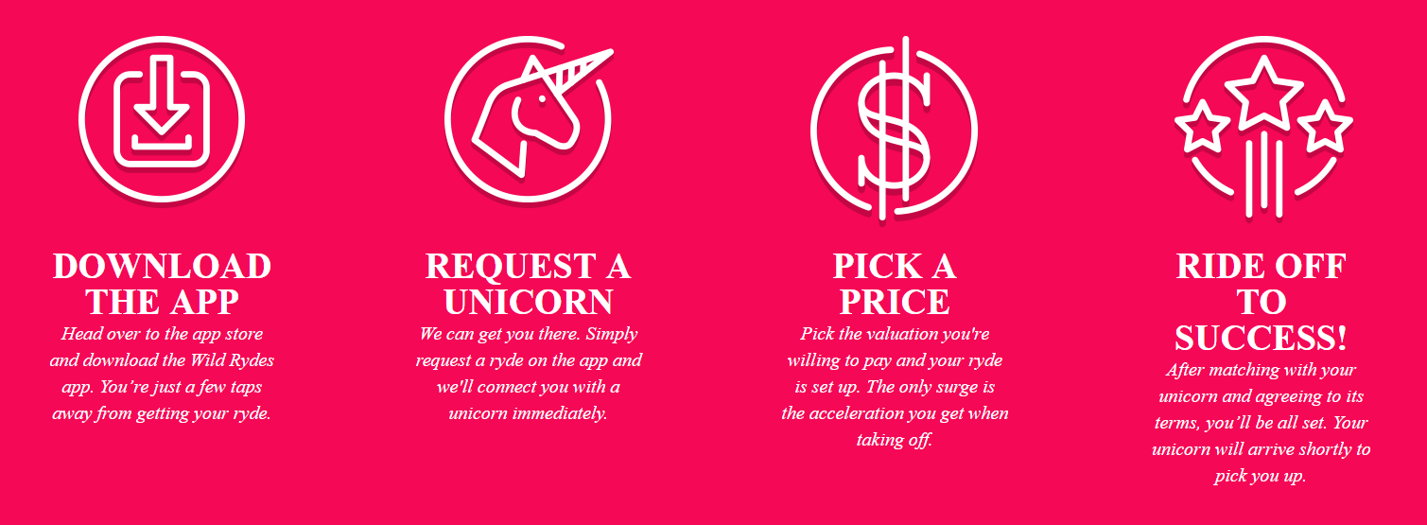
Help Wild Rydes Disrupt Transportation!
So how does this magic work?
Notes:
So how does the app work? (read through the four steps of how it works in the diagram)

Slide 5
Wild Rydes is Backed by Leading Investors
THE BARn ACCELErATOR
Tenderloin capital
Penglai communications and post new century
Technology corp limited
Notes:
Wild Rydes has successfully raised zillions in venture capital from top investors…
These investors have high hopes for Wild Rydes’ success.
However, they also want Wild Rydes to be frugal and efficient with its capital, which is why you’ll be using serverless computing to build economic web applications that are built for web scale.

Slide 6
Your Task: Build the Wild Rydes Website
Welcome to Wild Rydes Inc., Employee #3!
Notes:
And now, they’ve hired you, employee #3, to help it build out its technology platform! Your mission is to help Wild Rydes build a serverless web application!

Slide 7
The Serverless Spectrum

Slide 8
Microservices allow you to decompose for agility
Notes:
What microservices are
“…the microservice architectural style is an approach to developing a single application as a suite of small services, each running in its own process and communicating with lightweight mechanisms, often an HTTP resource API…” (Martin Fowler)
“Independently deployable services that work together, modelled around a business domain…” (Sam Newman)
“The technical authority for a business capability” (Udi Dahan)
What microservices are not
Defined by the number of lines of code
Services that only have subroutines (calculation or a validation) are functions, not a service
Services that only expose CRUD operations are RPC call to a database, not a service
REST / SOAP provide common interfaces for integration but don’t change the logical responsivity of the implementation
From monolith to microservices
Advantages:
Innovation: The fact that small teams can act autonomously and choose the appropriate technologies, frameworks, and tools for their domains is an important driver for innovation. Responsibility and accountability foster a culture of ownership for services.
Quality: Organizing software engineering around microservices can also improve the quality of code. The benefits of dividing software into small and well-defined modules are similar to those of object-oriented software engineering: improved reusability, composability, and maintainability of code.
Scalability: Fine-grained decoupling of microservices is a best practice for building large- scale systems. It’s a prerequisite for performance optimization since it allows choosing the appropriate and optimal technologies for a specific service.
Availability: Microservices architectures make it easier to implement failure isolation.

Slide 9
Microservices eliminate the need to focus on infrastructure as your critical differentiator
10%
90%
FOCUS ON INFRASTRUCTURE
FOCUS ON APPLICATIONS
Installing, configuring, and managing my compute infrastructure is critical to achieving my goals
Having a standardized, flexible, and on-demand compute environment is critical to achieving my goals

Slide 10
Domain Driven Design
“Ubiquitous language” –Modelling the language of the business
Provides guidance about model domains with entities, value objects, repositories and services
Top Tip!
Start reading from Chapter 11: Strategic Design vs Tactical Design
Notes:
Ubiquitous language practice of building up a common, rigorous language between developers and users.
Many people read the first part of the book that provides guidance on entities etc
Let’s take a brief look at some of the core concepts of strategic design.

Slide 11
Amazon views serverless as the native architecture of the cloud
No provisioning, no management
Automatic scaling
Pay for value
Highly available and secure
Source: Digital Rewrites The Rules Of Business, Forrester, February 2018

Slide 12
Serverless is an operational construct
COMPUTE
ELASTIC BEANSTALK
ECS/EKS
DATABASES
RDS ON MYSQL
AMAZON REDSHIFT
STORAGE
MESSAGING
RDS AURORA
EC2
MYSQL ON EC2
AMAZON MQ
ANALYTICS
EMR
FARGATE
HADOOP ON EC2
AURORA SERVERLESS
AMAZON ES
More operations
VM ON-PREM
MYSQL ON-PREM
STORAGE ON-PREM
EBS ON-PREM
HADOOP ON-PREM
ATHENA
SNS/SQS STEP FUNCTIONS
S3
DYNAMODB
LAMBDA
Less operations
Source: Digital Rewrites The Rules Of Business, Forrester, February 2018
Notes:
You have heard us talk about shared responsibility in the past. Simply stated, a shared responsibility model implies there are parts of the system that AWS is responsible for and there are parts of the systems that you as a customer must take responsibility for. In many cases we provide tools and there is a rich ecosystem of open source and commercial products that makes it easier for all of you to own your side of the responsibility box.
There is no one hard line on where this line is drawn between the two parts of shared responisbility. One one side of the spectrum you can leverage the power and flexibility of EC2 to run your own database. You can use something like RDS to simplify the management of the database or use RDS Aurora to completely offload the database storage infrastructure to an AWS managed backend. Alternatively you can move to a fully managed database like DynamoDB where you create tables, put data in those tables, and query the data. There is no infrastructure to manage. QoS is part of the the database service with sufficient knobs and dials to give you the right level of control.
The question we keep asking ourselves is: how can we draw this line in a way that allows our customers to innovate on business problems, but makes the underlying infrastructure less visible. Any time you spend coraling infrastructure is undifferentiated heavy lifting. Over the last 12 years as more and more people start in the cloud or move major applications to the cloud, this definition of "undifferentiated havy lifting has evolved"

Slide 13
Comparison of operational responsibility
AWS manages
Customer manages
More opinionated
AWS Lambda
Serverless functions
Data source integrations
Physical hardware, software, networking, and facilities
Provisioning
Application code
AWS Fargate
Serverless containers
Container orchestration, provisioning
Cluster scaling
Physical hardware, host OS/kernel, networking, and facilities
Application code
Data source integrations
Security config and updates, network config, management tasks
ECS/EKS Container-management as a service
Container orchestration control plane
Physical hardware software, networking, and facilities
Application code
Data source integrations
Work clusters
Security config and updates, network config, firewall, management tasks
EC2
Infrastructure-as-a-Service
Physical hardware software, networking, and facilities
Application code
Data source integrations
Scaling
Security config and updates, network config, management tasks
Provisioning, managing scaling and patching of servers
Less opinionated
Notes:
There is a spectrum of shared responsibility you have over your options for compute. With EC2, you can build and run things, but you manage integrations, scaling, security config, provisioning, patching etc. in addition to your code.
Compare that to Lambda, where all you mange is your application code.

Slide 14
AWS serverless advantage
AGILITY
ELASTICITY
TOTAL COST EFFICIENCY
“What took us just a few days to build using a serverless solution based on AWS Lambda would have taken us six months to build from scratch.” — Edmunds
“[We have] experienced near-zero downtime and near-zero performance degradation while serving 200–300 million IPO requests per month” — Financial Engines
“The size of our team is half of what is normally needed to build and operate a site of this scale.” — Bustle
“Using AWS Lambda, we’ve increased cost efficiency by a factor of two.” — FINRA
Notes:
Edmunds: https://aws.amazon.com/solutions/case-studies/edmunds-serverless/
Financial Engines: https://aws.amazon.com/solutions/case-studies/financial-engines/
FINRA: https://aws.amazon.com/solutions/case-studies/finra-data-validation/
Bustle: https://aws.amazon.com/solutions/case-studies/bustle/

Slide 15
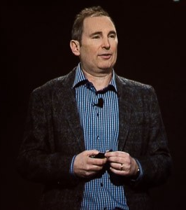
“If Amazon.com were starting today, it would go serverless”
— Andy Jassy
CEO, Amazon Web Services

Slide 16
Serverless Foundations

Slide 17
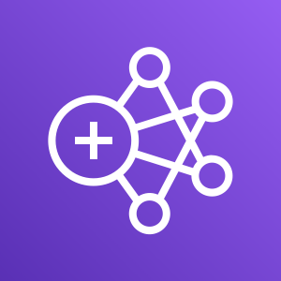
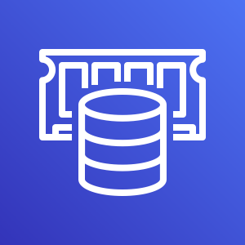
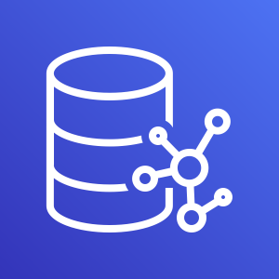
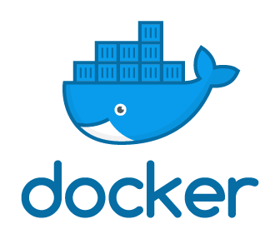
Spectrum of AWS offerings
On Amazon Elastic Compute Cloud (Amazon EC2)
Managed
Serverless
AWS
Lambda
Amazon
Cognito
Amazon
Kinesis
Amazon EMR
Amazon
RDS
Amazon
EC2
Amazon
Elasticsearch
AWS
StepFunctions
AWS
X-Ray
Amazon
Athena
Amazon
ElastiCache
Amazon
Redshift
Amazon
S3
Amazon
DynamoDB
Amazon
SQS
Amazon
Neptune
Microsoft SQL Server
Amazon
SageMaker
Amazon
MQ
Amazon
API Gateway
Amazon
CloudWatch
Amazon
SNS
Notes:
DOCUMENTDB - Landscape changing with Fargate and Aurora Serverless. Not complete list, etc.

Slide 18
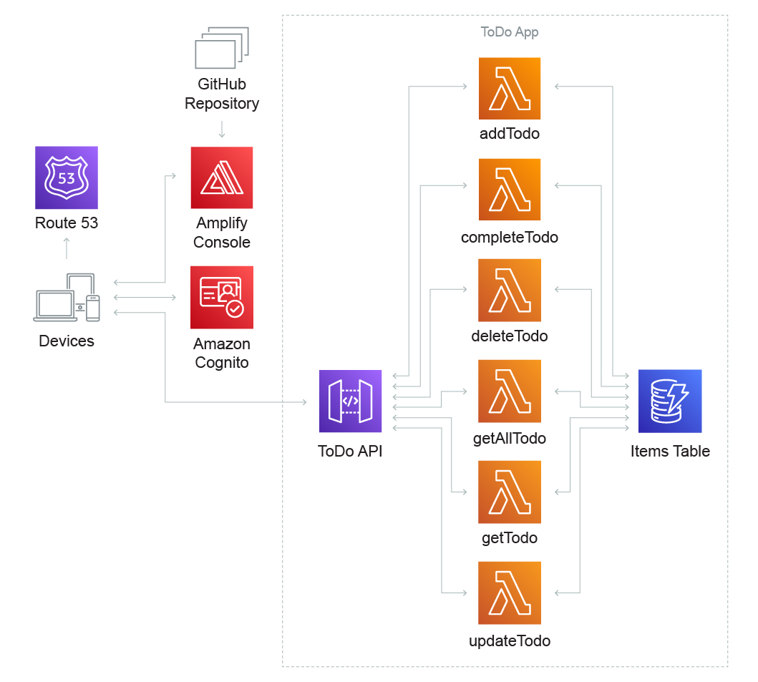
Use cases - Web applications

Slide 19
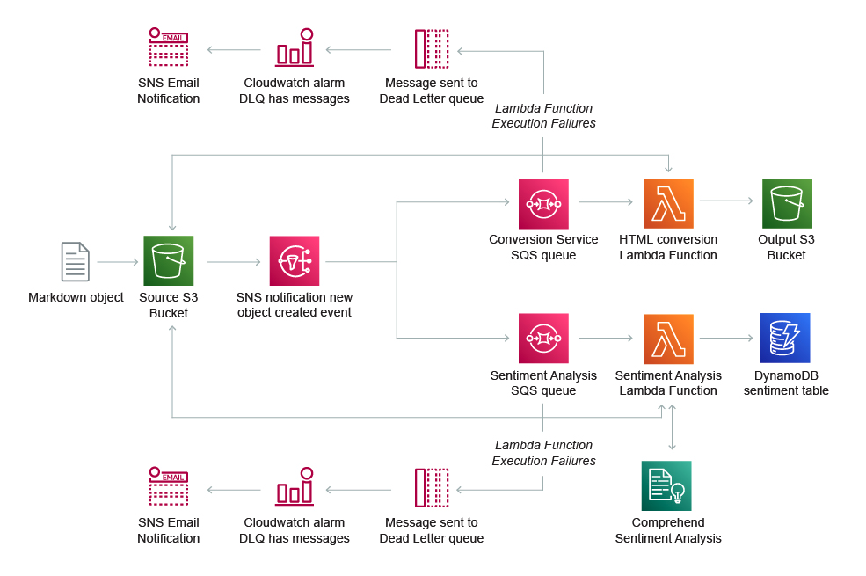
Use cases - Data processing

Slide 20
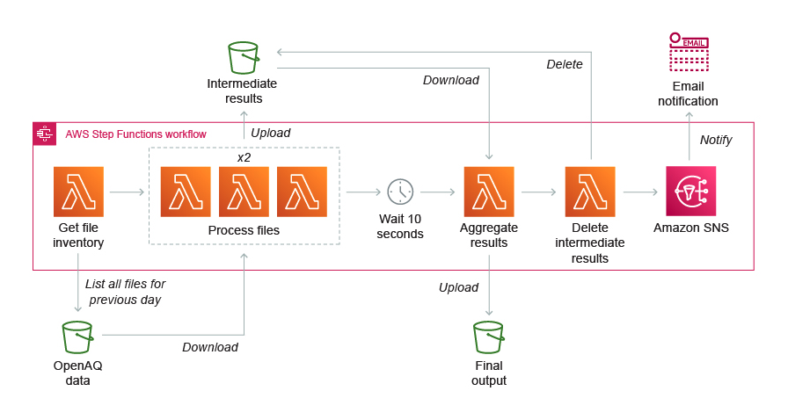
Use cases - Batch processing

Slide 21
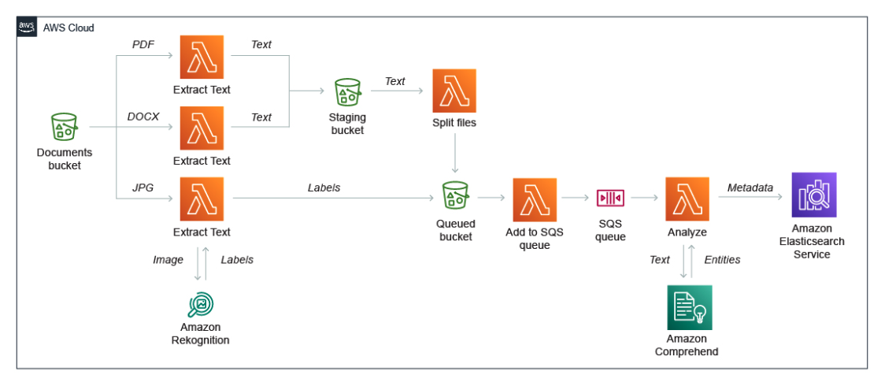
Use cases – Event ingestion

Slide 22
Let’s build!

